Slide 1

Agile Presentation
Michael Kinful CS-250-T5472

Slide 2

What exactly is a Scrum-Agile Team?
A Scrum-Agile team is essentially any team that utilizes the Scrum-Agile principles to develop and complete desired projects.
The Agile principle affords the team flexibility, fosters an environment of communication, and is extremely scalable based on project needs.
Now let’s meet the different roles on our Scrum-Agile Team, which consists of our Product Owner, Scrum Master, and Development/Testing team.
The team works in springs, which allows for large tasks to be completed quickly by ensuring that the team focuses on completing each feature assigned.

Slide 3

Product Owner
The Product Owner is responsible for developing and making sure that the vision of the project, always stays on course.
Ensures that all stakeholders are in constant communication.
Manages the overall product backlog.
Approves and rejects work results based on project requirements.
Updates stakeholders on progress of project.

Slide 4

Scrum Master
The Scrum Master is essential in maintaining the balance of the protect.
Helps the team transition from the Waterfall methodology to the agile methodology through coaching.
Ensures that all team members follow the correct Scrum-Agile principles.
The make sure that all deadlines are realistic and not something that would present an impractical deadline for the team to meet.

Slide 5

Development Team
The Development Team is responsible for translating ideas into code that builds the application.
Works closely with Product Owner and Scrum Master to ensure that the vision being created, aligns with the goals of the project.
Assures a high quality of standard by taking feedback from testers to fine tune and remediate all issues that are presented.
Constantly looking for ways to improve on the project and a tireless dedication to always learning and growing.

Slide 6

Testers
Testers are the quality assurance wing of the operation. A highly essential task that allows us to have a great product.
Performs quality assurance and provides feedback to the Development Team.
Designs and develop test cases by setting conditions to ensure that the code behaves the way it is intended to.
Reports all discovered bugs and documents findings.

Slide 7

How does the various phases of the SDLC work in an agile approach?
Let’s start by understanding what agile in SDLC consists of.

Slide 8
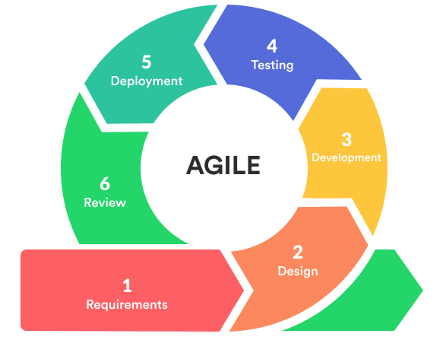
The Agile SDLC consists of 5 Phases.
Requirements
Design
Development/Testing
Deployment
Review

Slide 9
Requirements
Deployment
This is the phase in which the all stakeholders gather to discuss what the necessary requirements needed for the project.
This is the phase where development and testing has concluded, and the application can be launched to the end users.
Design
Review
The design phase where the basic layout of the project begins to take shape. It where the developers will define the technical details of the project from the UX/UI team.
After the application is deployed, the review phase is where we consistently update the application based on end-user feedback and fix crucial bugs that are discovered.
Development/Testing
The development phase is where the design is implemented through coding. It is where the first iteration of the product is created. After which, testing is conducted to make sure that the code behaves the way it is meant to.

Slide 10
What is the Waterfall method?
Unlike Agile, the Waterfall principle is a linear and sequential approach that makes it extremely beneficial for smaller projects. Due to its extremely structured approach, Waterfall is a lot easier and simpler to understand.
But the simplicity comes as a cost, its strict linear approach makes it difficult once the project scales up and changes are required to be made on a consistent basis.
A small change being made with the Waterfall method, might necessitate a complete design, as the sequential approach makes it difficult to be adaptable as well as more expensive.
Waterfall can be a great methodology if the project at hand does not require any complexity and adaptability of the code to grow and evolve. It also allows the project to be completed in a much faster time due to its simplicity.

Slide 11
What are the factors that are considered when choosing agile or waterfall approach?
Waterfall
Agile
Waterfall is simpler to use but is not very scalable for large sized projects.
Very difficult to make changes once project moves into final phases.
Testing is separate from development, making it harder to make changes after development.
Limited interaction amongst teams.
Takes longer to complete projects and can be generally more expensive.
Agile is flexible which allows for more changes during scalable projects.
Testing is part of the development process, making it easier to implement changes quicker.
Communication is a major key, which allows teams to work faster and stay on the same path.
Ensures that development quality is maintained throughout the development process.
Projects are developed quicker.

Slide 12
Would you choose an Agile methodology or a Waterfall methodology.
For our team, we decided on the on Agile methodology for reasons that stemmed from changes required to complete the project.
When our travel site was nearing completion, the decision was made to change the overall design philosophy to a wellness web application. With most projects, this would have spelled disaster, but due to our reliance on the Agile methodology, we were all able to maintain consistent communication as spearheaded by the leadership team, we were able to persevere and complete the project to our satisfaction and the satisfaction of the end-users.
In this ever-changing world that is the tech industry, one’s ability to adapt is no longer a premium, but a requirement if an organization seeks to be relevant. This is where Agile comes into play for our team. While the Waterfall method has served us well with previous smaller projects, the increasing number of complexities housed within our projects, necessitates that we choose the Agile methodology.

Slide 13
References
Hamilton, T (2023) Guru99
https://www.guru99.com/waterfall-vs-agile.html
na (2022) InterviewBit https://www.interviewbit.com/blog/agile-vs-waterfall/

